Slide 1


Practical Guide for Building a 3D Web App from 2D Data
Kristian Ekenes
Raluca Nicola
2018 Esri DEVSummit Conference | Palm Springs, CA

Slide 2






Kristian Ekenes
Raluca Nicola
Product Engineer JS API
Product Engineer JS API
Data visualization, Smart Mapping, Arcade
Data visualization, 3D
Redlands, California
Zurich, Switzerland
Notes:
Not sure if this slide is worth it. We present ourselves anyway

Slide 3
You will learn
Notes:
Motivation – why are they here

Slide 4
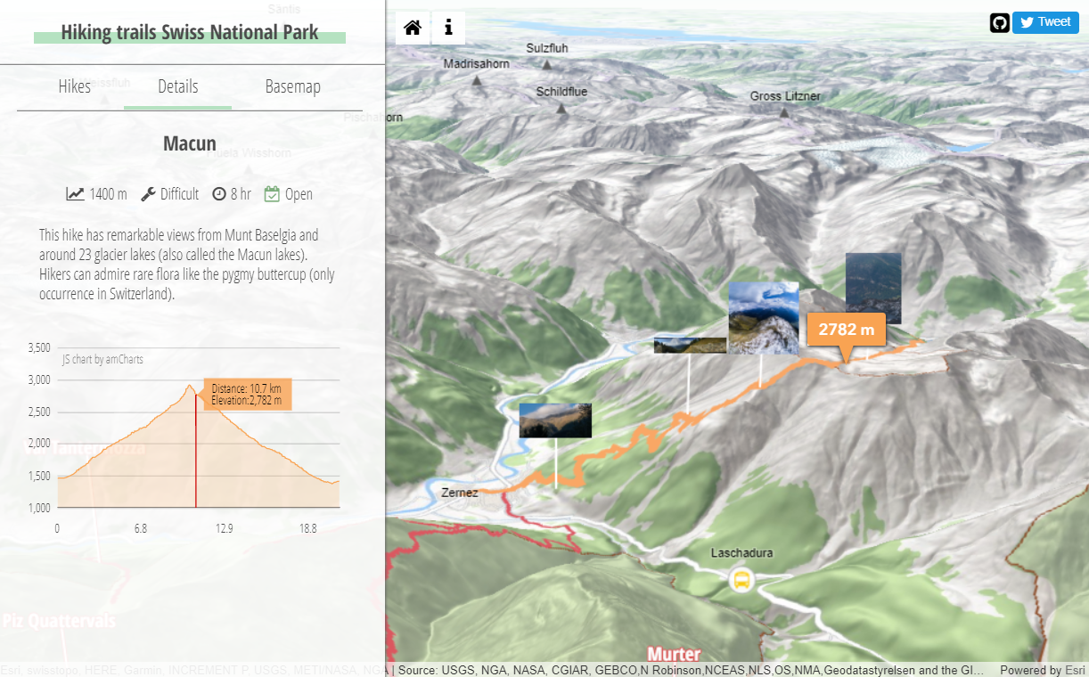
how to create this
Notes:
Motivation – why are they here
They’ll learn how to visualize data like this

Slide 5
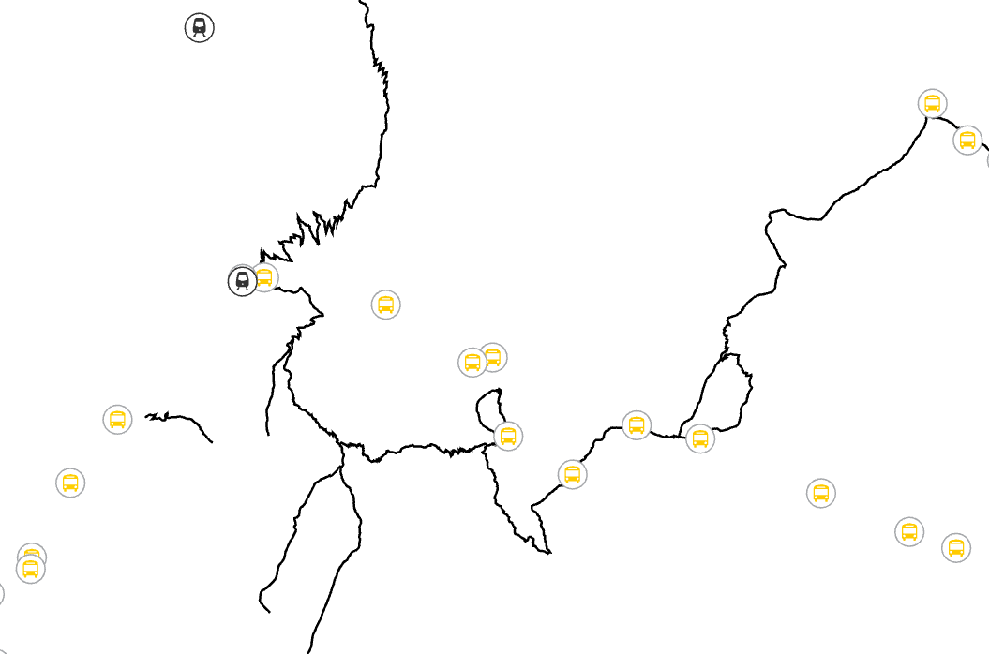
when all you have is this
Notes:
Motivation – why are they here
They’ll learn how to visualize data like this

Slide 6
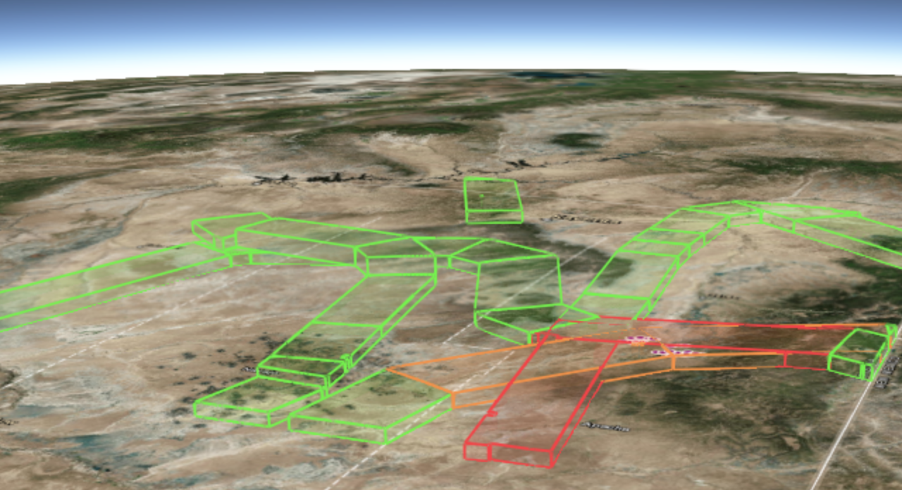
how to create a 3D analysis app
with 2D data
Notes:
Motivation – why are they here
They’ll learn how to visualize data like this

Slide 7
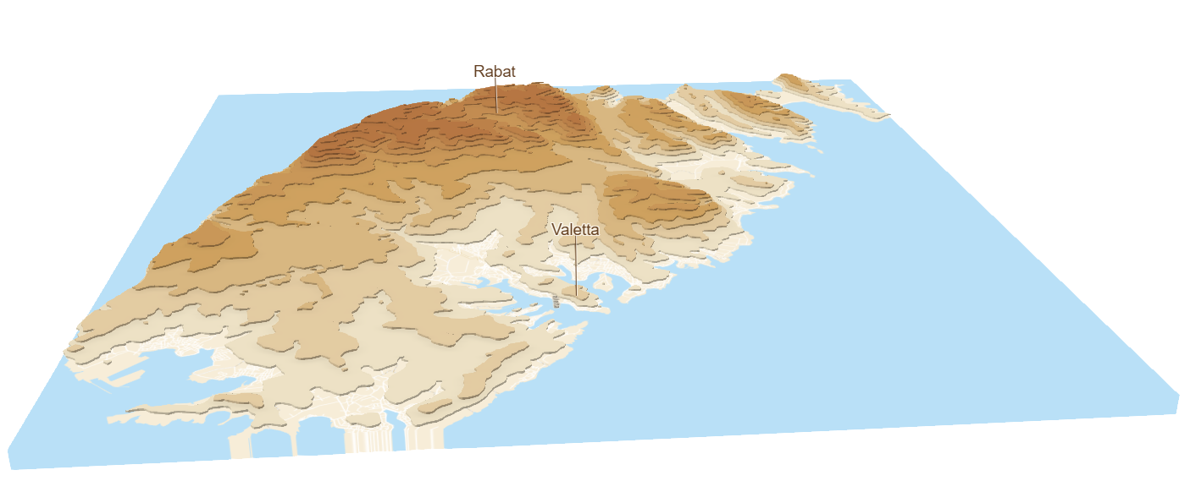
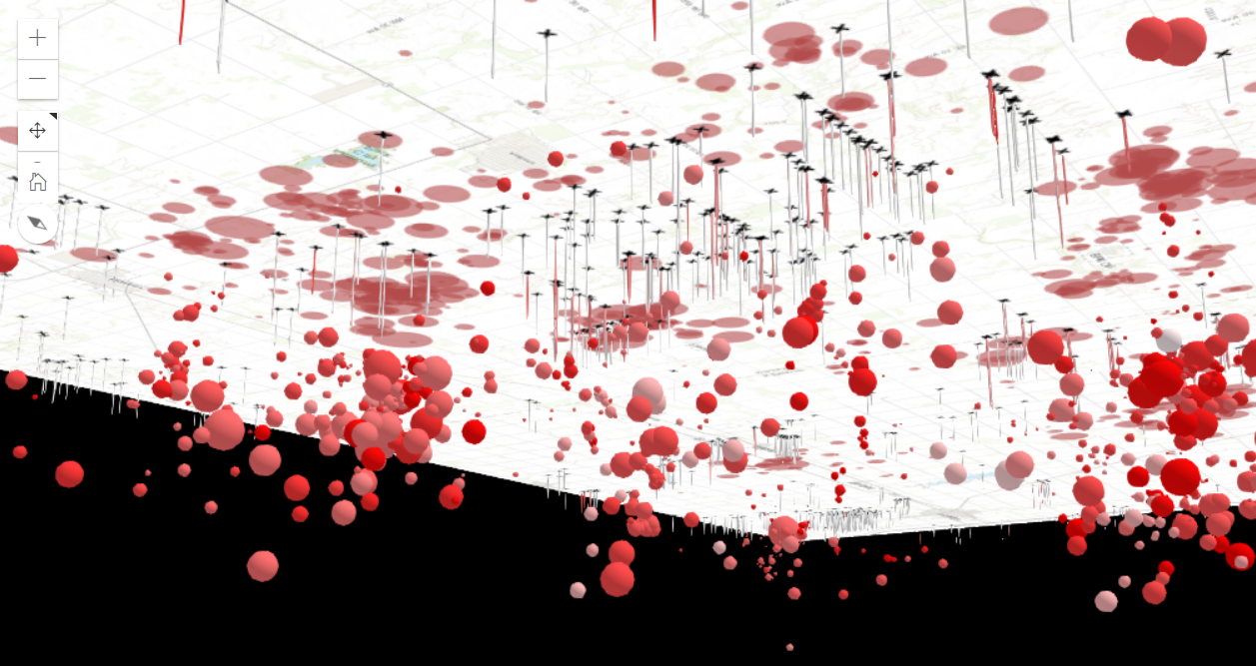
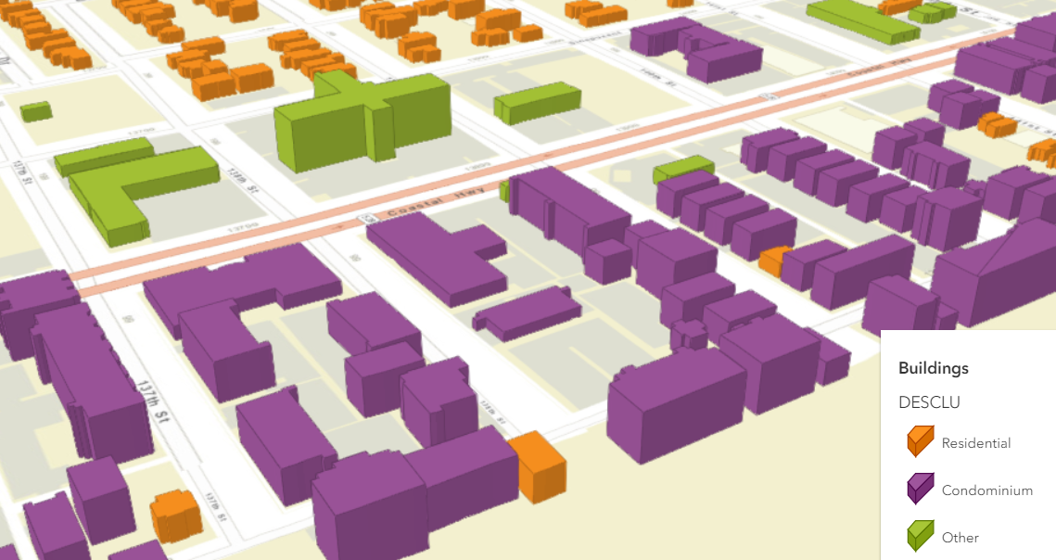
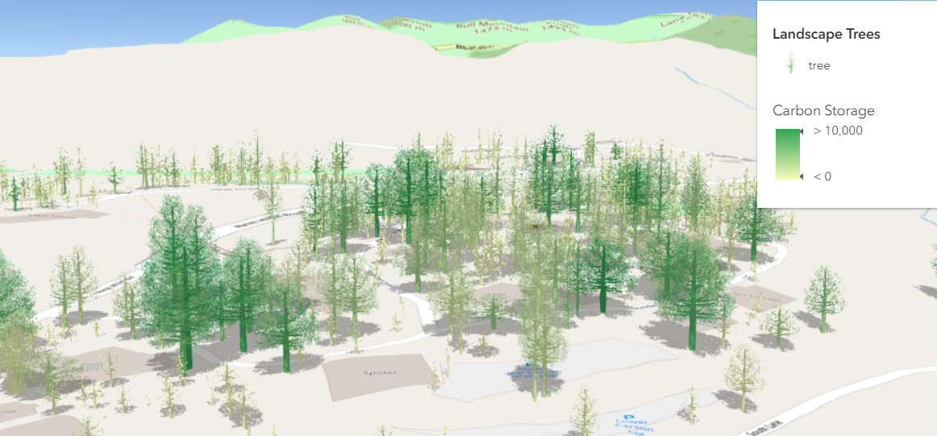
and some other examples

Slide 8
Airspace encroachment
analysis
Hiking trails –
Swiss National Park
Other visualizations
20 min
20 min
10 min

Slide 9

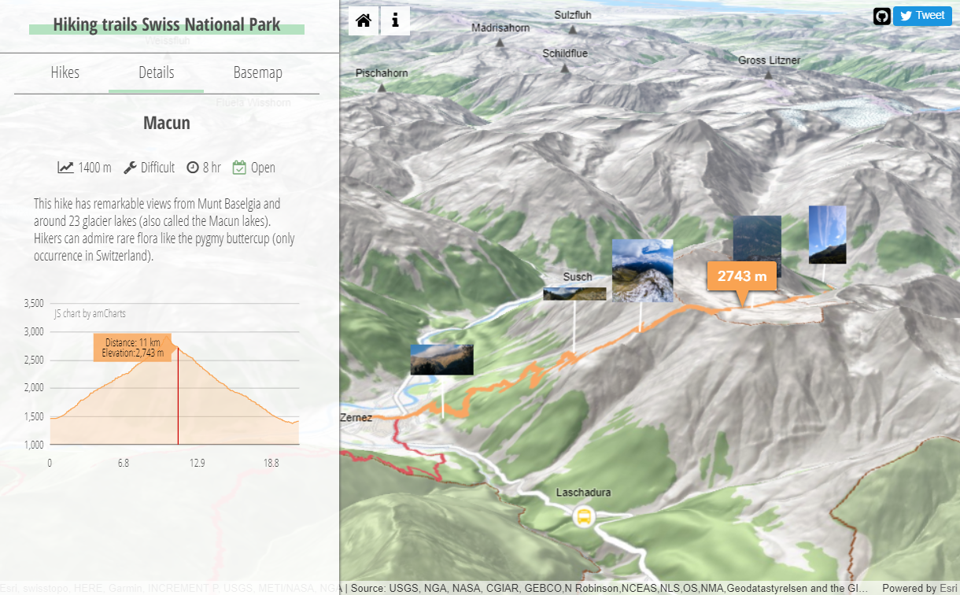
Hiking trails
Swiss National Park

Slide 10
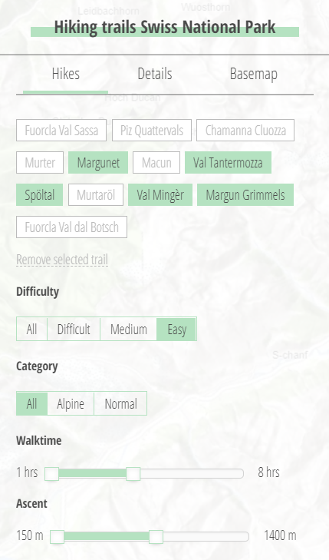
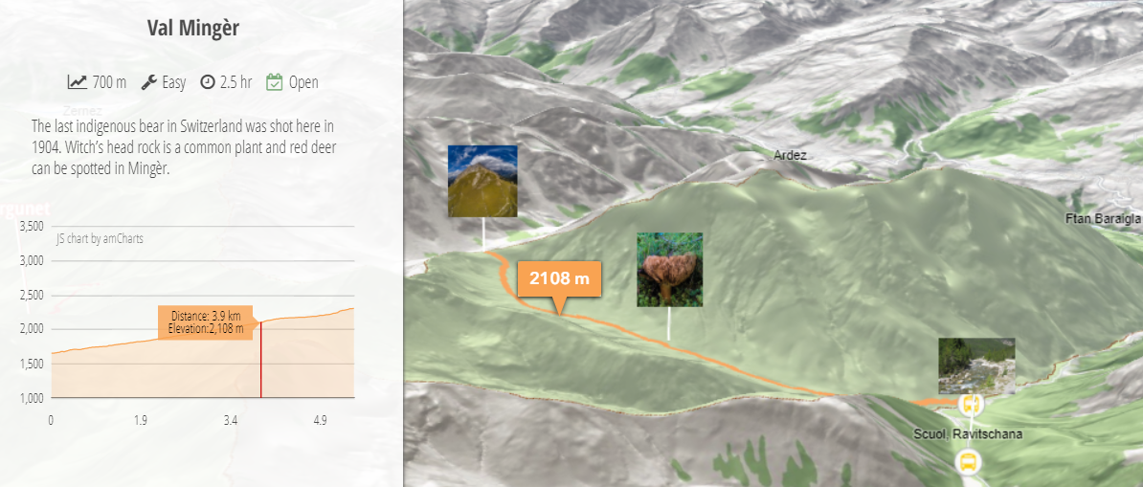
Goals
View and filter trails
Show details about each path: description, elevation profile, images

Slide 11
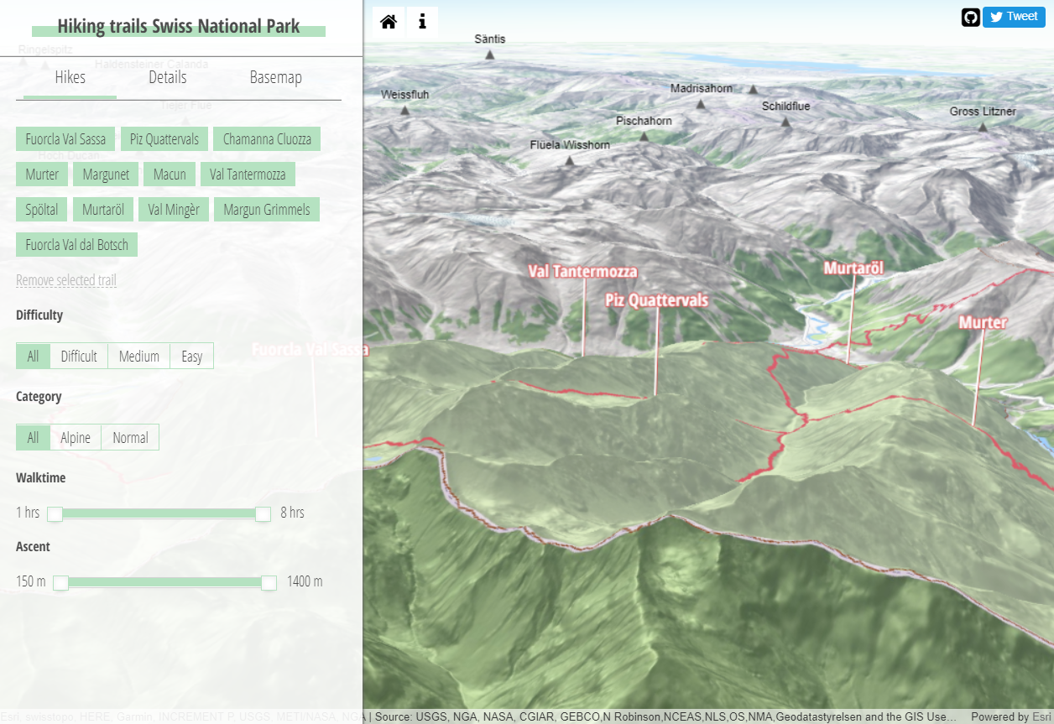
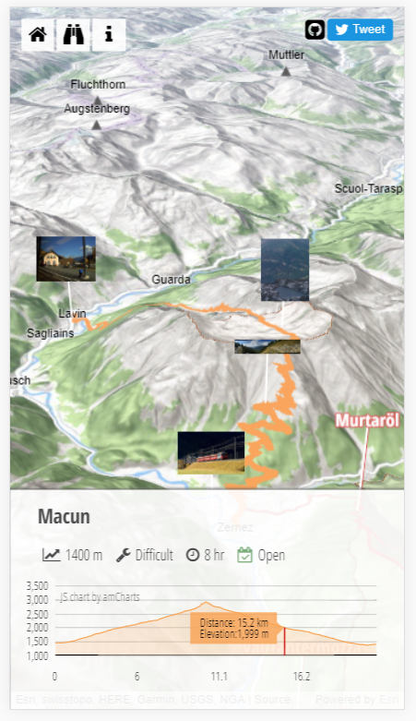
Resources
Swiss National Park
Hiking trails - 2D line data
Bus stops – 2D points
ArcGIS API for
JavaScript
OSM
Mountain peaks – 2D points
Village names – 2D points
(& AMCharts)
ESRI
Basemaps & satellite imagery
Elevation service
Flickr
Image REST API

Slide 12
Filtering
definitionExpression – an SQL clause used for client side feature filtering
layer.definitionExpression = "RouteId = 10 OR RouteId = 20";

Slide 13
Elevation profile
elevationLayer.queryElevation – queries the elevation layer for elevation values for the given geometry
// call the queryElevation method on the ground
// with 2D geometry (multipoint, point, line)
elevationLayer.queryElevation(feat.geometry, {
demResolution: "finest-contiguous"
noData: 1500
})
.then((response) => {
// prints geometry with z values obtained
// by querying the underlying elevation service value
console.log(response.geometry);
});

Slide 14
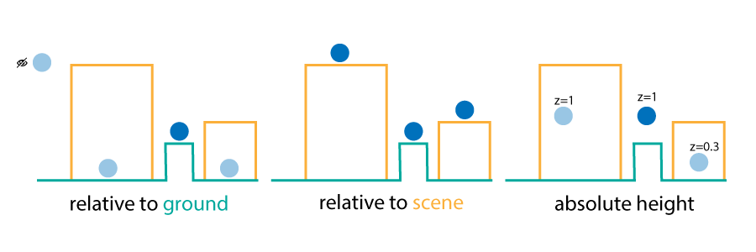
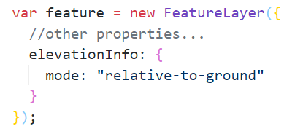
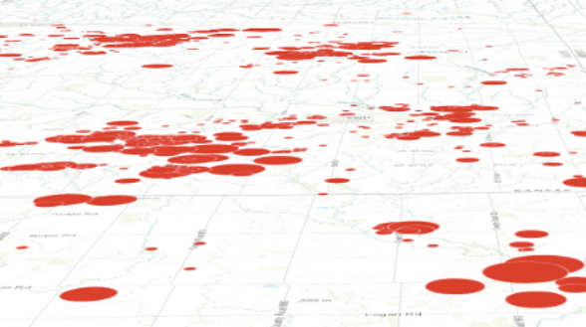
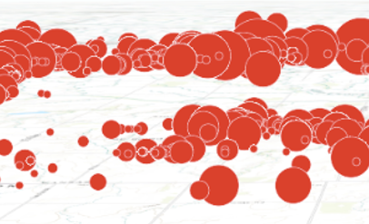
elevationInfo
on the ground
relative to ground

Slide 15

Line labeling
new FeatureLayer({
// set properties like url and renderer here
labelsVisible: true,
labelingInfo: [new LabelClass({
symbol: new LabelSymbol3D({
symbolLayers: [new TextSymbol3DLayer({…})],
verticalOffset: {
screenLength: 80,
maxWorldLength: 3000,
minWorldLength: 200
},
callout: {
type: "line",
size: 1,
color: "white"
}
}),
labelExpressionInfo: { expression: `$feature.name`}
})]
});
Labels with callouts on lines
Hiking trail 1

Slide 16
Set images in the scene
const billboard = new PointSymbol3D({
symbolLayers: [new IconSymbol3DLayer({
size: 50,
resource: {
href: `https://url.com/image.jpg`;
}
})],
verticalOffset: {
screenLength: 50,
maxWorldLength: 3000
},
callout: {
type: "line",
size: 1,
color: "white"
}
});
IconSymbolLayer works with any image
on click add it to the DOM and
transition it to full screen

Slide 17
Airspace Encroachment Analysis
Military Training Routes

Slide 18
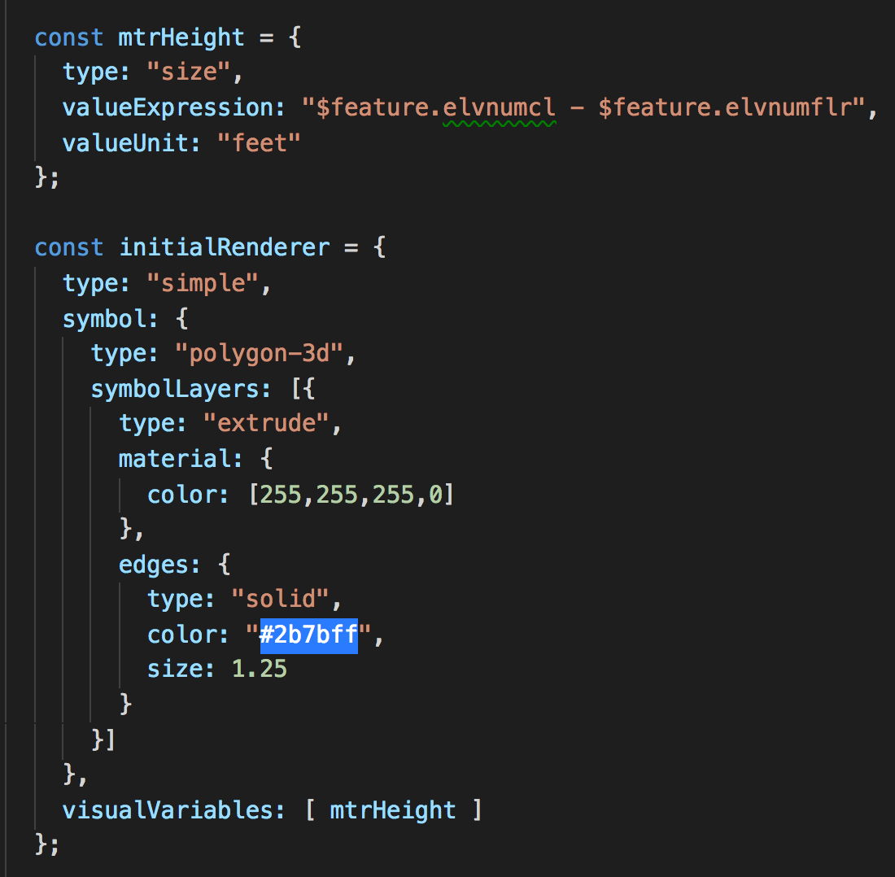
Real world size
Using data attributes to size features based on real world size.

Slide 19
Elevation offsets

Slide 20
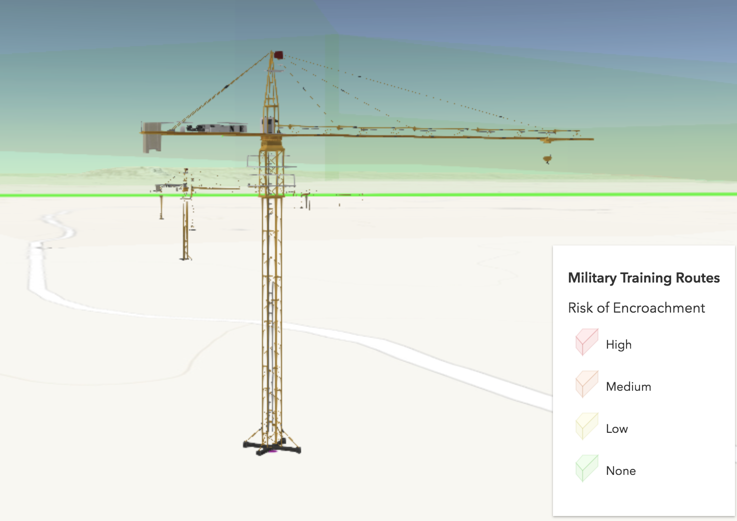
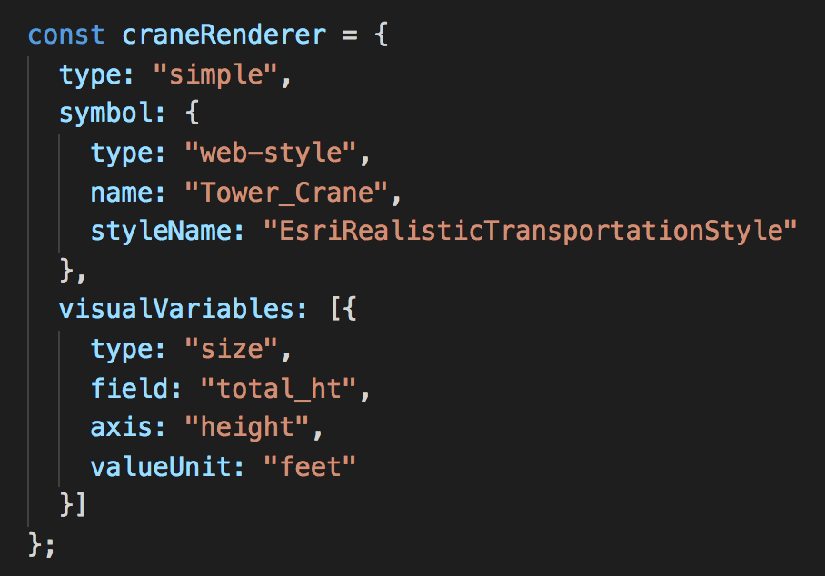
Realistic symbols
aka Web Styles…

Slide 21
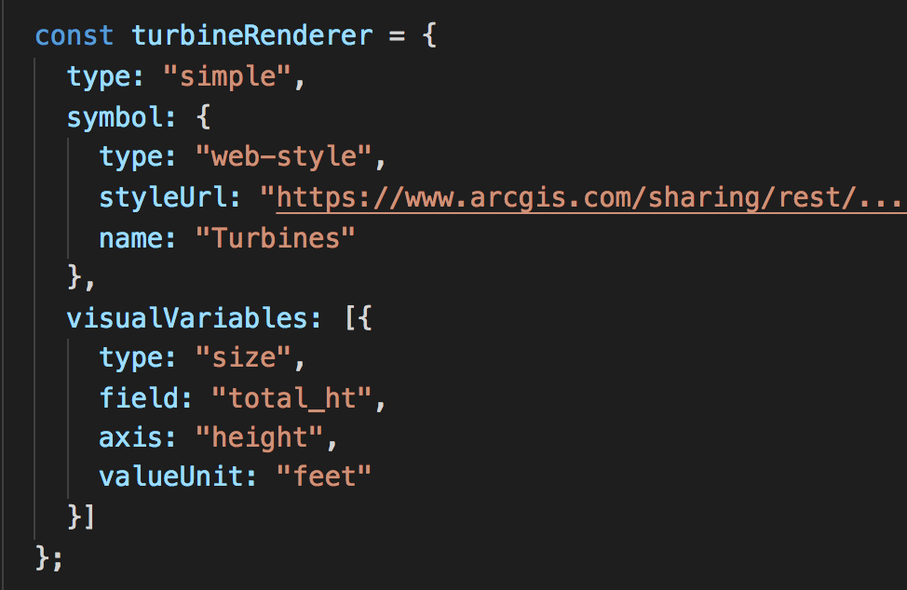
Realistic symbols
Web Styles published from ArcGIS Pro

Slide 22
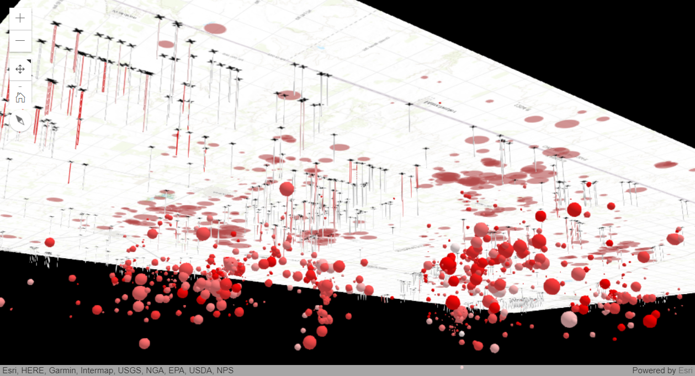
Underground visualization

Slide 23
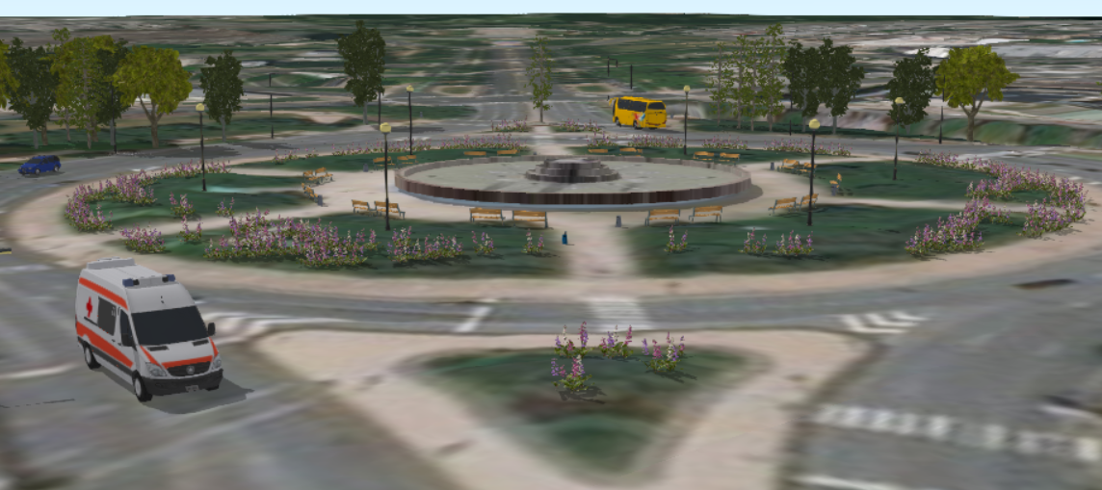
Documentationsamples

Slide 24
Terrain visualization
Using contour lines

Slide 25
Resources
ArcGIS API for JavaScript SDK samples:
https://developers.arcgis.com/javascript/latest/sample-code/index.html?search=webstyle
Making the leap to 3D - http://www.esri.com/esri-news/arcuser/fall-2017/making-the-leap-to-web-3d (ArcUser article)
Hiking app – https://github.com/RalucaNicola/hiking-app
Airspace encroachment analysis app – https://github.com/ekenes/conferences/tree/master/ds-2018/3d-viz-2d-data/demos/mtr

Slide 26



